Slide 1
IBM University Engagement Project Submission
“Exploring the Power of Agentic AI with IBM Granite and IBM Bob”

Slide 2
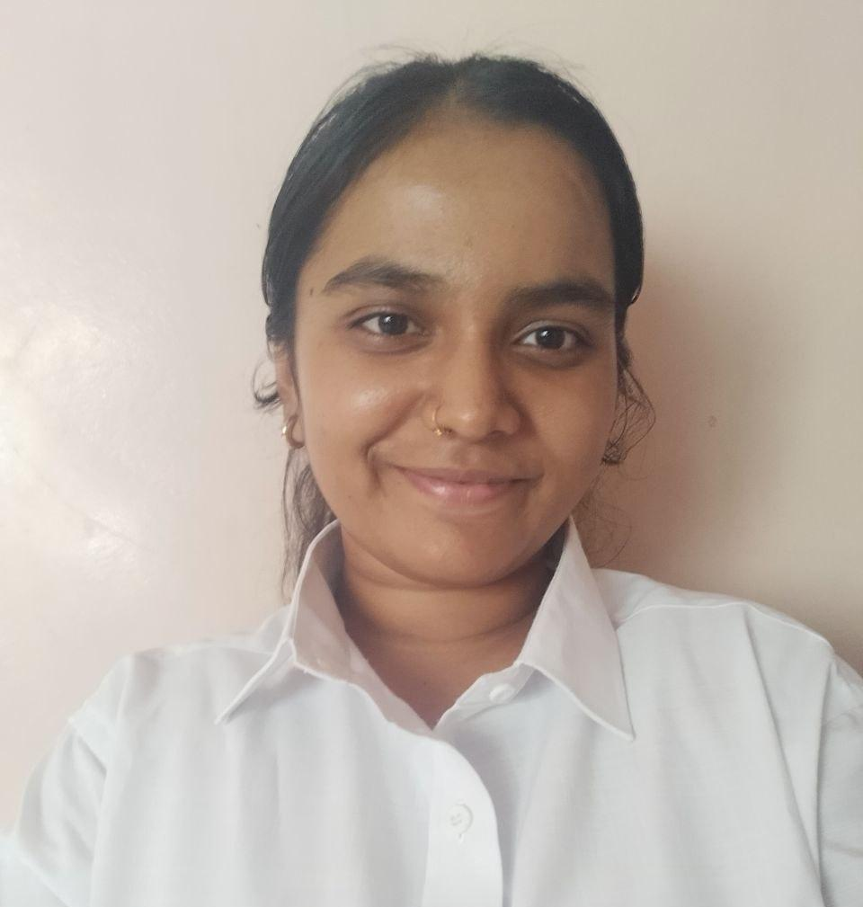
Project Tile – AI-Powered Digital Financial Literacy Agent-FinWise AI
Domain of Project – Finance / Financial Literacy
Student Name | Recent Passport Photo | Email ID | Mobile number [WhatsApp]
Shruti Mallikarjun Halle |  | Shrutihalle2@gmail.com | 8459324097

Slide 3
Problem Statement -AI Agent for Digital Financial Literacy
The Challenge
Digital financial services such as UPI, online banking, digital wallets, loans, and online payments have become part of everyday life. However, many users are not fully aware of safe digital payment practices, financial fraud prevention, budgeting, saving, and basic financial concepts.
Users often receive financial information from unreliable sources, which can lead to confusion, scams, unsafe transactions, or poor financial decisions. There is a need for a simple and trustworthy AI-based solution that provides financial education in an easy-to-understand way.
The Objective
Build an AI-powered Digital Financial Literacy Agent that:
Explains UPI and digital payments
Provides online scam and fraud awareness
Helps users understand budgeting and saving
Explains loans and interest rates
Promotes safe digital banking practices
Provides beginner-friendly financial education
Helps users make informed financial decisions

Slide 4
Proposed Solution -FinWise AI
FinWise AI is an AI-powered digital financial literacy agent designed to educate users about everyday financial topics in a simple, practical, and responsible manner.
The agent uses a knowledge-based approach to provide information on UPI, digital payments, online scams, budgeting, savings, loans, interest rates, and banking safety.
Users can interact with the agent using natural language and receive step-by-step explanations. The system focuses on financial education rather than making personalized investment decisions or guaranteeing financial outcomes.
Key Features
💳 UPI & Digital Payment Education
🛡️ Scam & Fraud Prevention
💰 Budgeting & Saving Guidance
🏦 Digital Banking Safety
📊 Personal Finance Basics
💵 Loan & Interest Rate Education
🌐 Beginner-Friendly Interaction
🤖 AI-Powered Assistance

Slide 5
Technology Used
IBM Bob
Used to develop the project and create the AI-powered application.
IBM AI / Agentic AI
Used to provide intelligent, conversational assistance and automate responses to user queries.
Knowledge Base / RAG Approach
The agent uses a connected financial-literacy knowledge source to retrieve relevant information before generating responses.
HTML, CSS & JavaScript
Used for the user-facing website interface.
IBM Cloud / watsonx Orchestrate
Used where applicable for deploying and interacting with the AI agent.
Trusted Financial Sources
The knowledge content focuses on reliable sources such as RBI, NPCI, SEBI and government financial-safety resources.

Slide 6
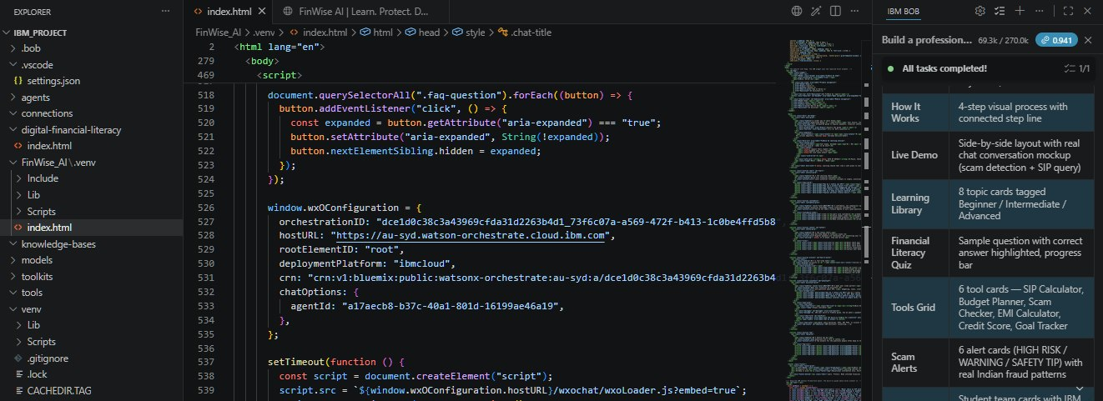
Required Files created using IBM bob -
Project Files:
📄 index.html — Complete FinWise AI website, including HTML, CSS, JavaScript, and chatbot integration
⚙️ .env — Environment/configuration variables required for the project

Slide 7
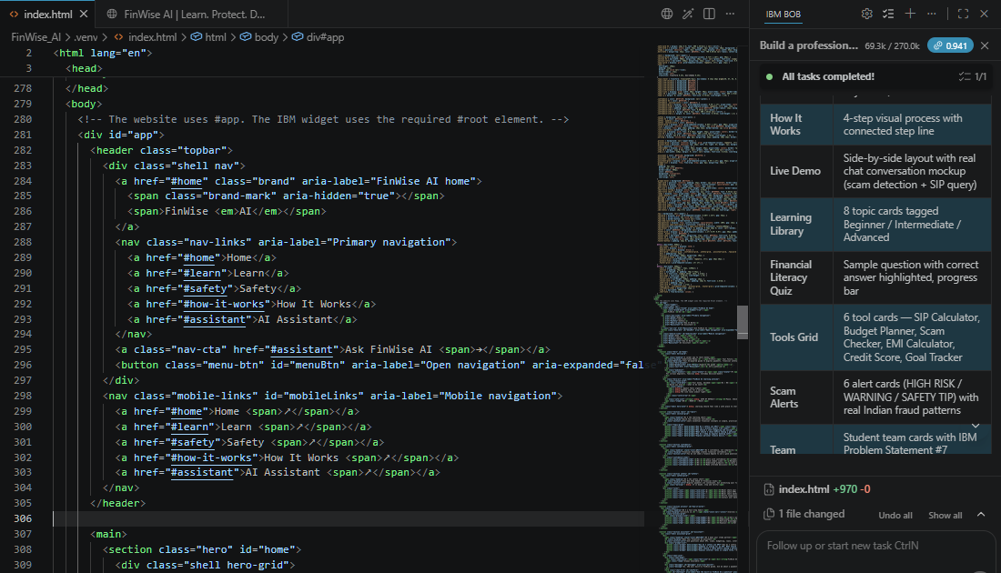

Slide 8
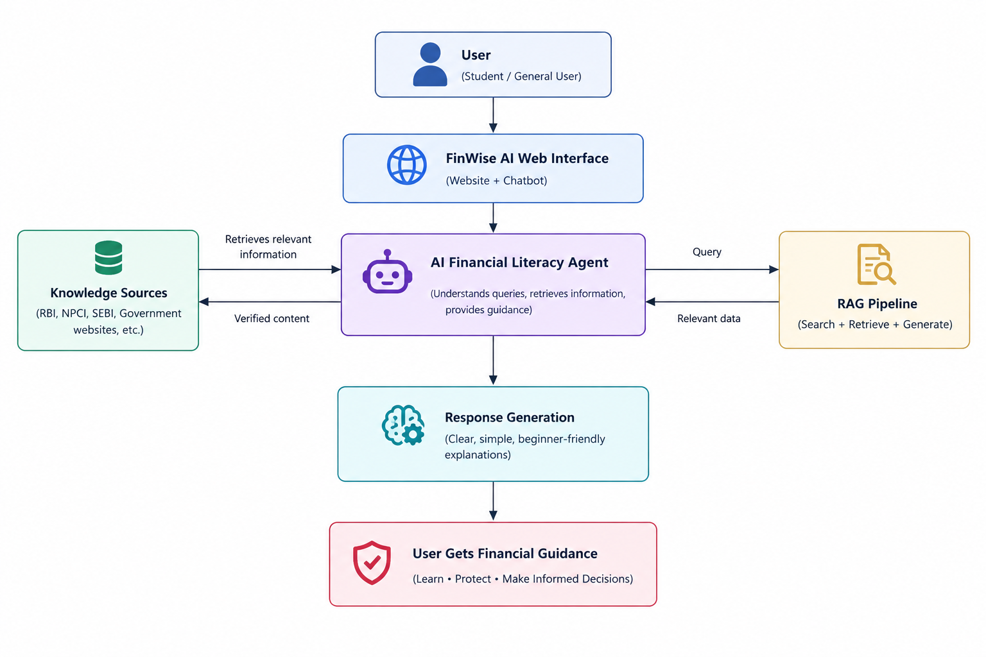
Architecture blueprint for IBM bob:

Slide 9

Role of Agentic AI in the solution
Agentic AI enables FinWise AI to understand a user's financial question, identify the relevant topic, retrieve appropriate information, and generate a useful response.
The agent can handle different financial-literacy topics such as digital payments, fraud prevention, budgeting, savings, loans, and banking safety without requiring users to navigate complicated information sources.
Key Roles
Understands natural-language questions
Identifies the user's financial topic
Retrieves relevant knowledge
Generates clear explanations
Provides step-by-step guidance
Prioritizes financial safety
Avoids unsupported financial claims
Helps users make informed decisions

Slide 10
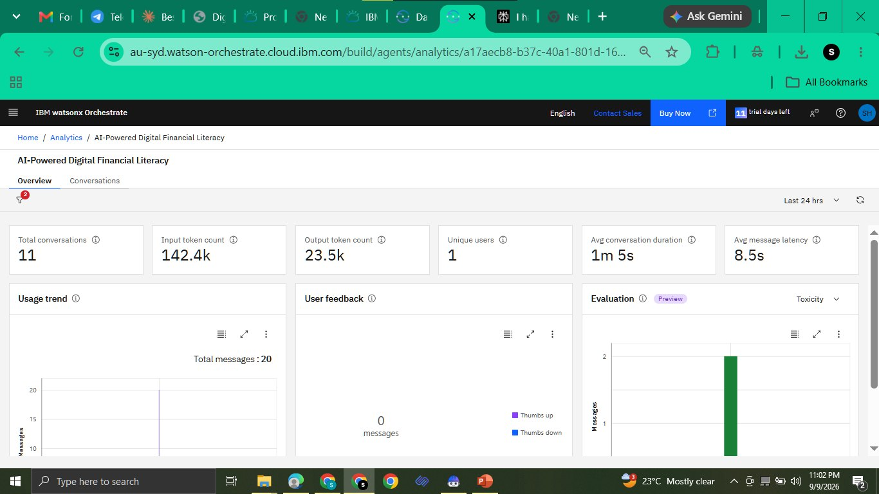
Token Usage
142.5K token are used
After the Prompt
·
·
·

Slide 11
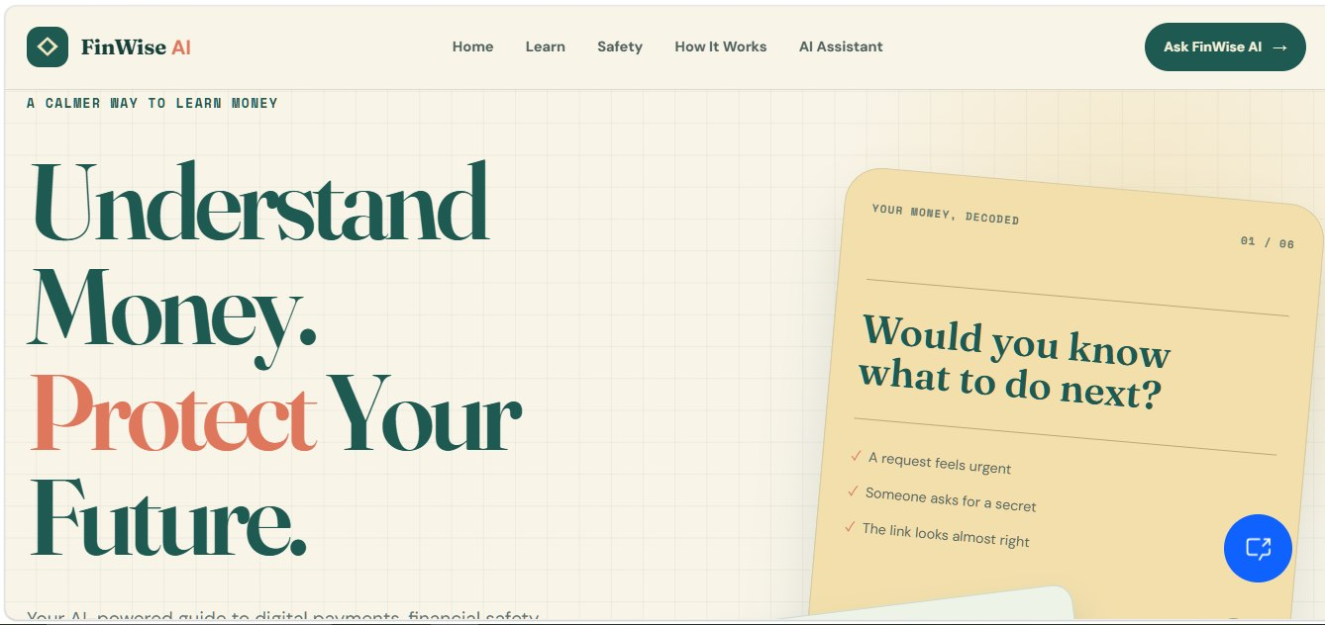
Project Output Screenshot
Please put IBM Bob output screenshots with 2-3 prompts.
You can take 2-3 more slides for each screenshot
·
·
·

Slide 12
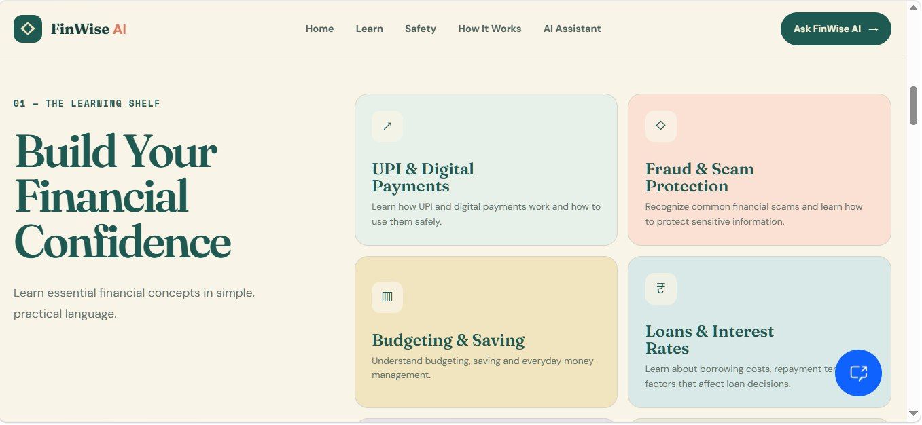
Project Output Screenshot
Please put IBM Bob output screenshots with 2-3 prompts.
You can take 2-3 more slides for each screenshot
·
·
·

Slide 13
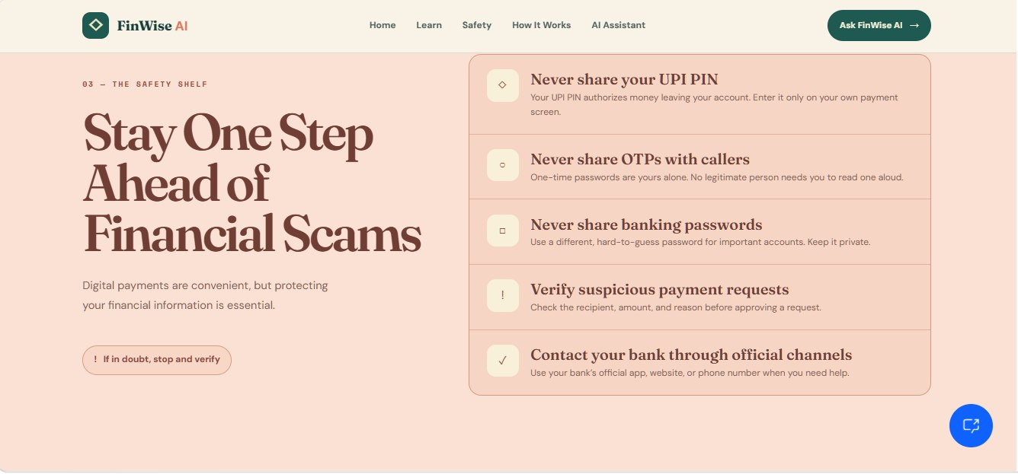
Project Output Screenshot
Please put IBM Bob output screenshots with 2-3 prompts.
You can take 2-3 more slides for each screenshot
·
·
·

Slide 14
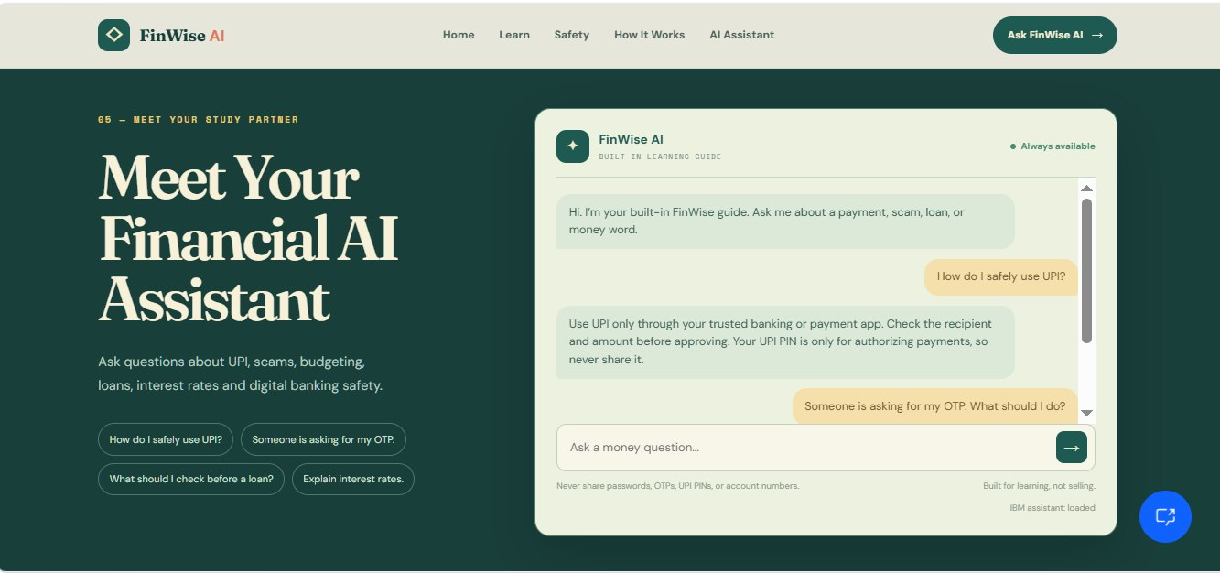
Project Output Screenshot
Please put IBM Bob output screenshots with 2-3 prompts.
You can take 2-3 more slides for each screenshot
·
·
·

Slide 15
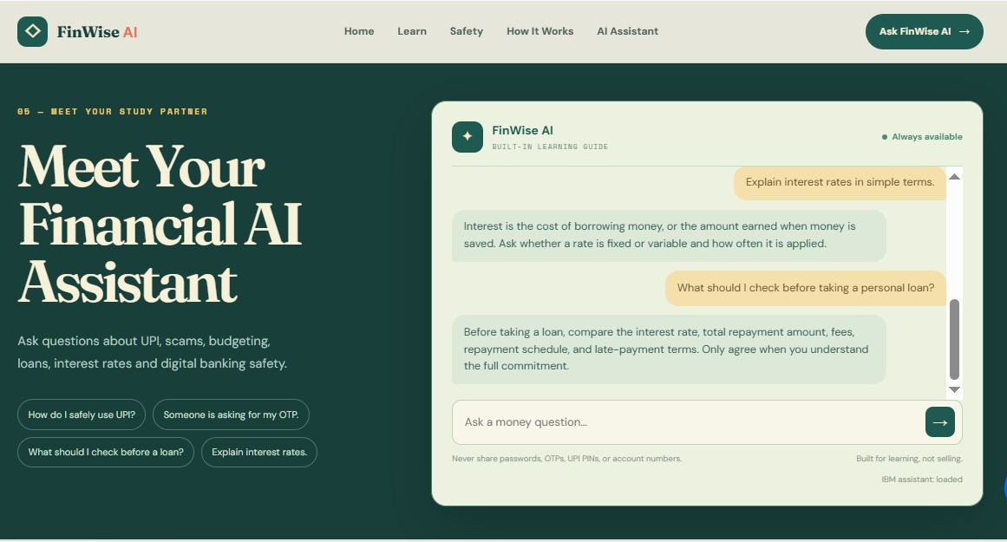
Project Output Screenshot
Please put IBM Bob output screenshots with 2-3 prompts.
You can take 2-3 more slides for each screenshot
·
·
·

Slide 16
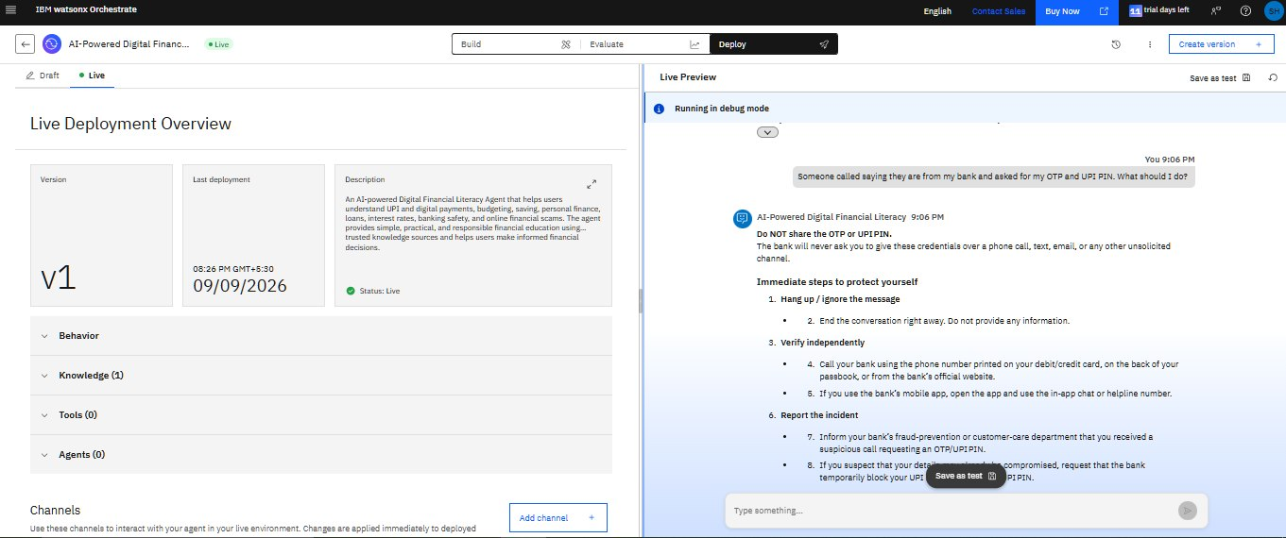
Project Output Screenshot
Please put IBM Bob output screenshots with 2-3 prompts.
You can take 2-3 more slides for each screenshot
·
·
·

Slide 17
Novelty and Uniqueness
FinWise AI combines Agentic AI, financial knowledge retrieval, and digital-safety education into one accessible platform.
Key Innovations
1. AI-Powered Financial Education
Provides instant explanations of common financial concepts.
2. Fraud Awareness
Helps users recognize and respond safely to common digital-finance scams.
3. Knowledge-Based Responses
Uses a connected financial-literacy knowledge source to improve reliability.
4. Beginner-Friendly Communication
Explains complex financial concepts using simple language.
5. Responsible Financial Guidance
Focuses on education and avoids guaranteed returns or personalized investment recommendations.
6. Multiple Financial Topics
Covers UPI, banking safety, budgeting, savings, loans and fraud prevention.

Slide 18
Git Hub Link
GitHub Repository:
https://github.com/Shruti-Halle/finwise-ai-digital-financial-literacy
Repository Contents:
📄 Problem Statement PDF
🌐 index.html — Complete FinWise AI website
📘 README.md — Project documentation
🖼️ Project images/screenshots
📊 Project Presentation (.pptx)
·
·
·

Slide 19
Future Scope
1. Multilingual Financial Assistance
Support multiple Indian languages to make financial literacy accessible to more users.
2. Voice-Based Financial Assistant
Allow users to ask financial questions using voice.
3. Real-Time Fraud Alerts
Future versions could provide updated information about emerging digital-payment scams.
4. Personalized Budgeting
Users could optionally enter income and expenses to receive educational budgeting insights.
5. Mobile Application
FinWise AI could be extended into a dedicated Android/iOS application.
6. Financial Institution Integration
Future versions could integrate verified information from banks and financial institutions.
7. Improved Knowledge Updates
The knowledge base could be regularly updated with new financial-safety information and regulations.
·
·
·

Slide 20
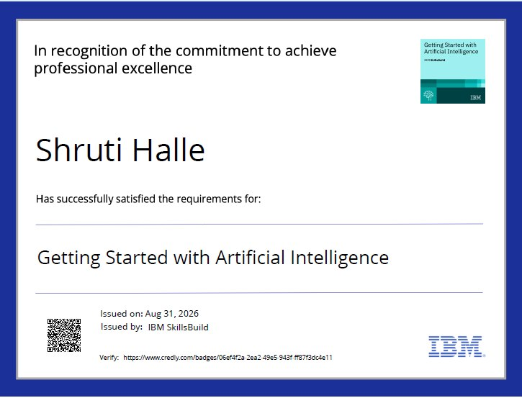
Certificates Earned:
(Getting Started with Artificial Intelligence)

Slide 21
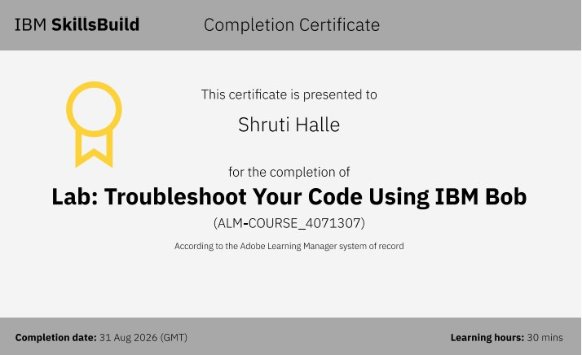
Certificates Earned:​
IBM BOB Certificate

Slide 22


